Slide 1

Governance, Risk and Compliance (GRC) Platform
For monitoring and reporting compliance to NCS-CRF

Slide 2
Presentation Agenda
Objectives and goals of the GRC platform
Summary of the Key Features & Modules
GRC Wireframe Architecture
Mock Views of the GRC Platform
Key Considerations
Implementation Details

Slide 3
Overview of the NCF-CRF GRC Platform
The multi-tenanted GRC platform will enable the NCC to have complete visibility of cyber risks and compliance with the Framewok across the sector
Enable service providers to automate workflows for risk, compliance, and audit of NCS-CRF standards
Useful for NCC-CSIRT to manage it’s own GRC issues
Provide real-time insights and dashboards on the cyber resilience capabilities and maturity of service providers and the sector.
Enhance efficiency in managing regulatory, legal, and operational requirements at
  Entity (service provider) level
  Sectoral level

Slide 4
Key Success Criteria
Single source of truth for risk and compliance across Service Provider (SP) and Sectoral levels
Measurable reduction in compliance reporting time for SP and NCC CSIRT to NCC management
Improved audit readiness for SP and regulator oversight confidence.
Ease of adoption and implementation of the CRF by SPs.
Demonstrated ROI for service providers within 12–18 months
Complete visibility of the cyber resilience of the Sector and CNII

Slide 5
Key Functional Features of the GRC Platform

Slide 6
Compliance & Standards Alignment
The platform is built to support the NCS-CRF. However, it can also be used by SPs and NCC report compliance with other frameworks/standards like:
  NDPA
  NCPS
  ISO 27001
  NIST Cybersecurity Framework
  PCI DSS
  Other international frameworks
  Custom frameworks (ICOP, Code of Corporate Governance etc)

Slide 7
Risk Management
Provide a risk register with taxonomy support (strategic, operational, IT, third-party).
Enables qualitative and quantitative risk assessments.
Manage end-to-end risk assessments and treatment workflows
Enable the implementation of controls in a single platform
Provide Key Risk Indicators (KRIs) with thresholds and alerts.
Provide a risk appetite framework and risk heatmaps.
Enable scenario planning and stress testing of the service provider’s cyber resilience.

Slide 8
Compliance Management
Repository of regulations, standards, and frameworks.
Control mapping and smart mapping across multiple frameworks.
Regulatory change tracking and impact assessment.
Automated and customised compliance assessments and attestations
Create tests that continuously monitor existing or custom controls

Slide 9
Audit Management
Audit planning and scheduling to enable streamlining the audit process to ensure auditors have a clear understanding of the test, its evaluation criteria, and the data used for validation
Evidence collection automation
Solution for monitoring and collecting endpoint configuration evidence
Workpaper management with version control.
Findings management and remediation tracking.
Reporting for audit committees, the board, and regulators

Slide 10
Third-Party Risk Management
Vendor onboarding and due diligence workflows.
Third-party risk assessment questionnaires with agentic AI to collect vendor documents, review them against set criteria, flag gaps, and follow up (Paid add-on)
Derive the third-party impact rating or integration with external vendor risk rating services.
Continuous monitoring of supplier risks as part of the service provider’s risk register
Contract repository and compliance tracking, as well as reports to management of service providers

Slide 11
Incident & Issue Management
Centralized incident capture and categorization.
Root Cause Analysis and Corrective Action Plans.
Linkage of incidents to risks, controls, and compliance requirements.
Automated escalation and notifications

Slide 12
Policy Management
Policy lifecycle management (draft, review, approve, distribute, acknowledge).
Repository of policy templates to aid the compliance programme.
Archive out-of-scope policies
Build custom policy templates
Automation of asset collection by importing assets from spreadsheets, cloud repositories, API stacks, etc

Slide 13
Reporting & Analytics
Real-time dashboards for executives and operational teams.
Risk and compliance heatmaps.
Automated board and regulator-defined reports.
Predictive analytics and AI-driven insights (Paid ad-on)

Slide 14
NON FUNCTIONAL FEATURES

Slide 15
Key Non Functional Features
Security
Role-Based Access Control (RBAC)
  Granular user permissions
  Segregation of duties
Data Encryption & Privacy
  Encryption in transit and at rest
  Compliance with data privacy laws (e.g., GDPR, NDPA)
Audit Trails & Logs
  Comprehensive user activity logging
  Tamper-proof records for compliance verification

Slide 16
Key Non Functional Features
Performance & Scalability
  A cloud-based SaaS solution, on-premises option may be considered.
  Global scale (multi-timezone, multi-currency).
  High availability (99.9% uptime SLA).
Usability
  Intuitive and modern User Interface/User Experience.
  Configurable dashboards for different user roles.
  Mobile-friendly access

Slide 17
Key Non Functional Features
Advanced Capabilities (Optional, for a fee)
  AI/ML for risk prediction, anomaly detection, and remediation suggestions.
  Natural Language Processing (NLP) for regulatory text analysis.
  Continuous Control Monitoring (CCM).
  Low-code/no-code workflow customization

Slide 18
Integration & Interoperability
  Open APIs for third-party integrations.
  SSO integration with enterprise identity providers.
  Connectors for ERP, HR, ITSM, SIEM, and IAM.
  Integration with regulatory feeds for threat intel sharing

Slide 19
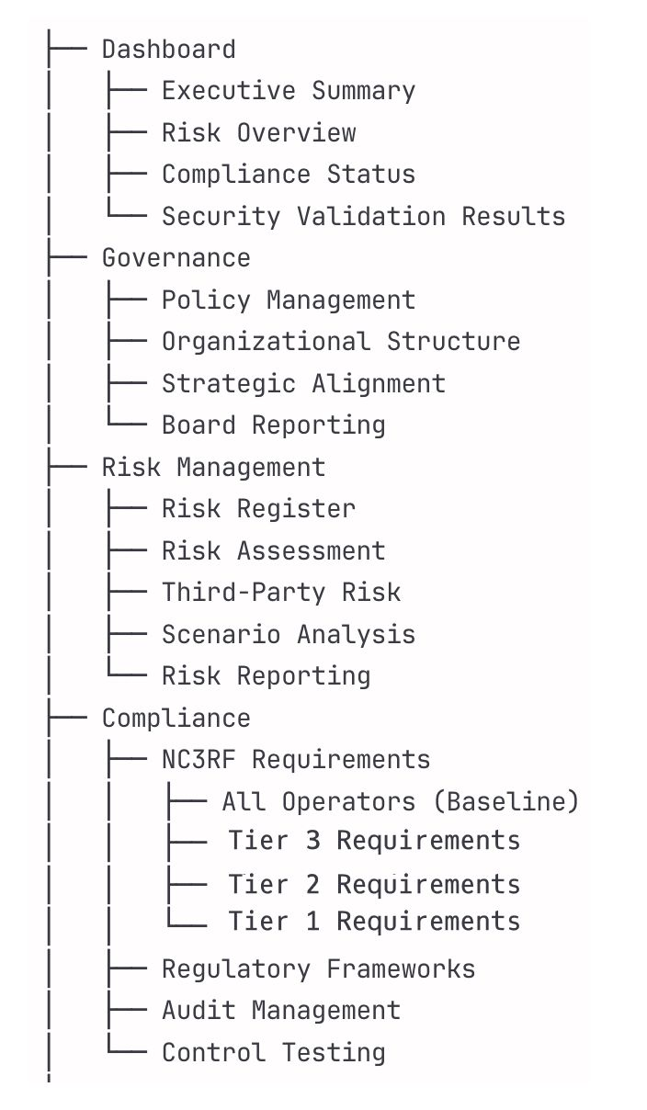
Wireframe Architecture

Slide 20
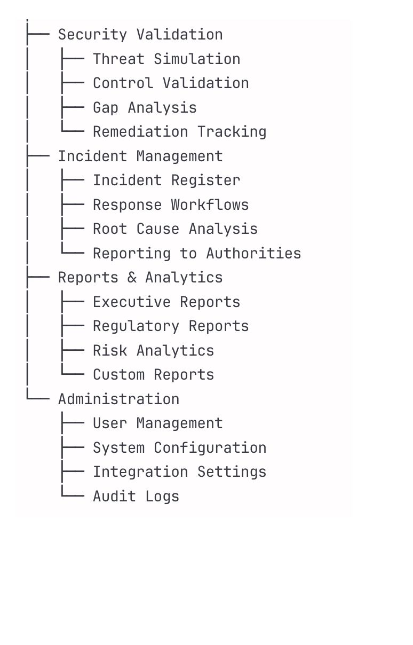
Wireframe Architecture

Slide 21
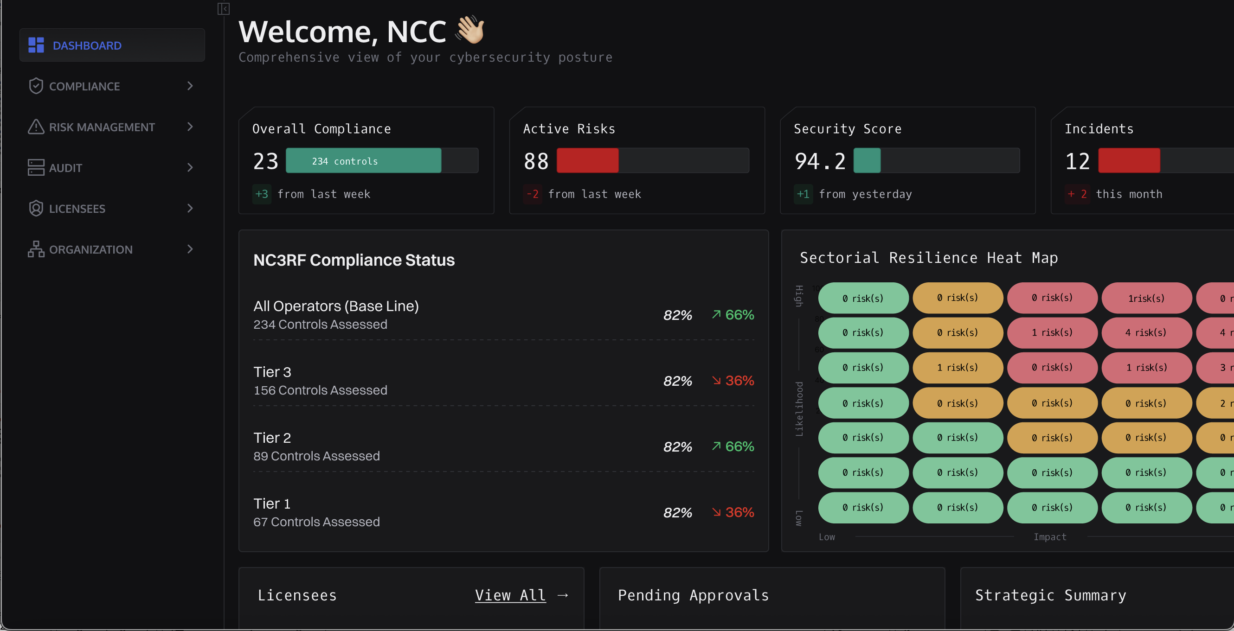

Slide 22
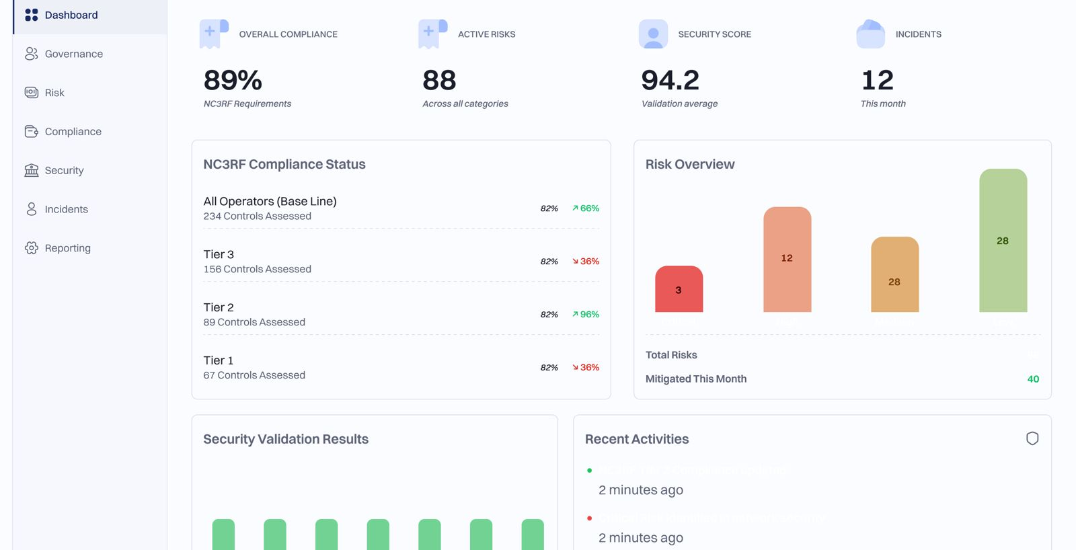

Slide 23
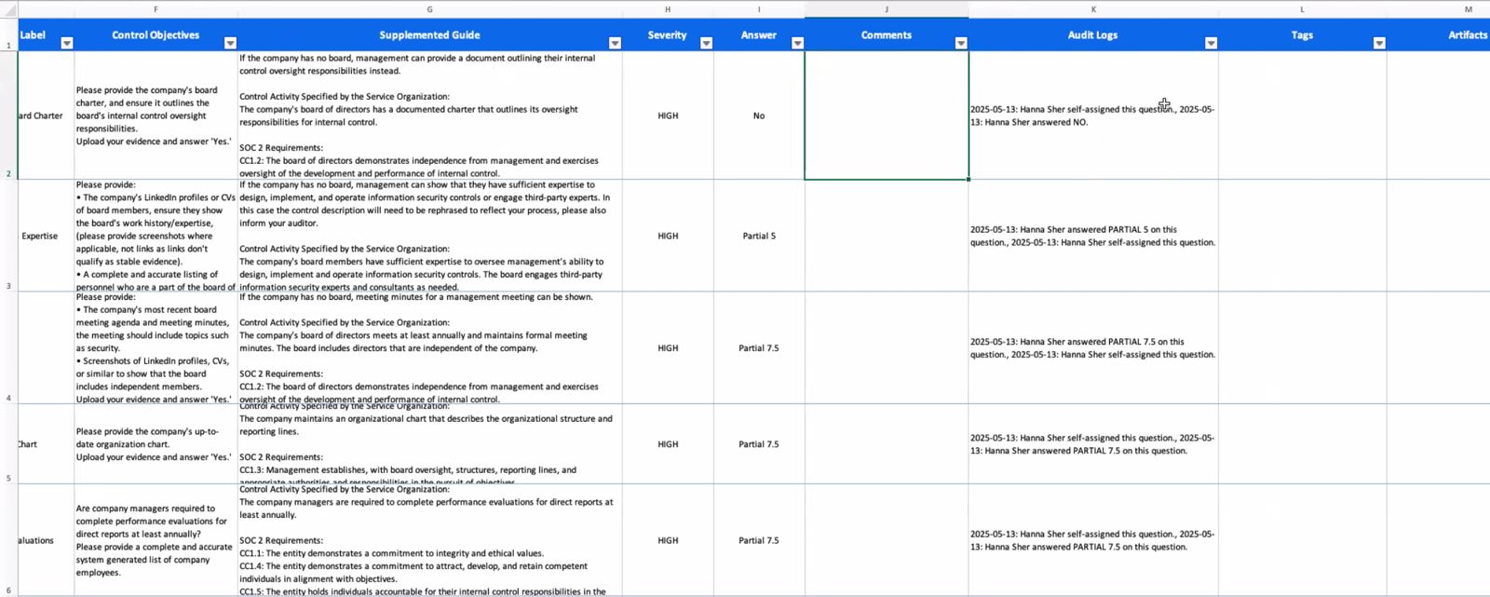
On-boarding Template

Slide 24
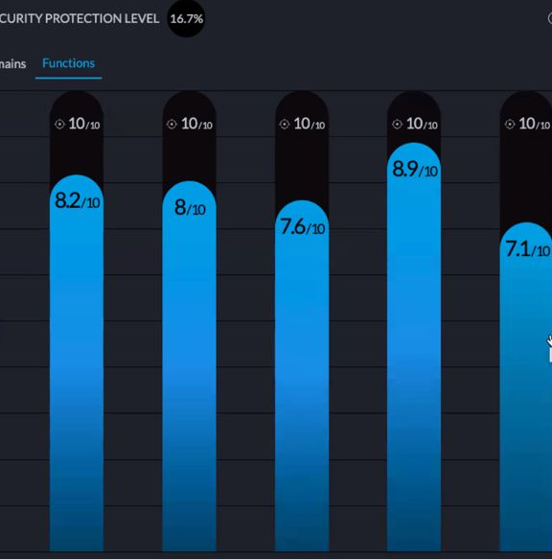
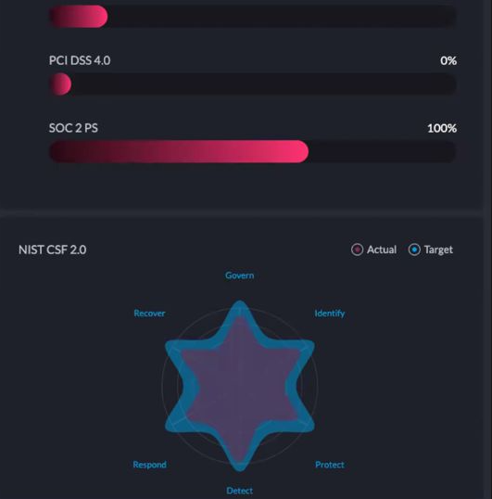

Slide 25
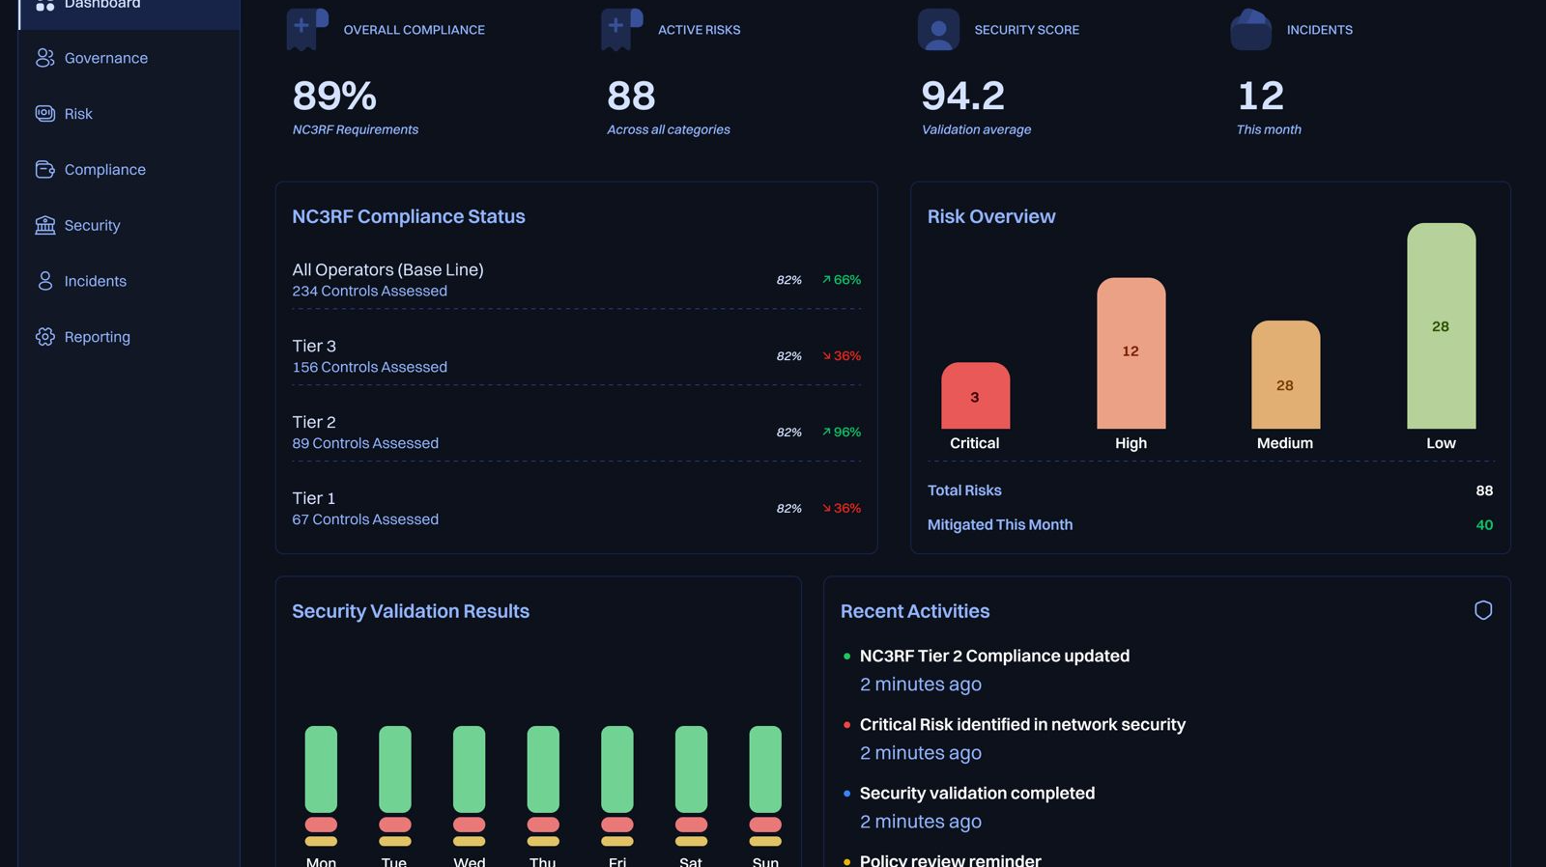

Slide 26
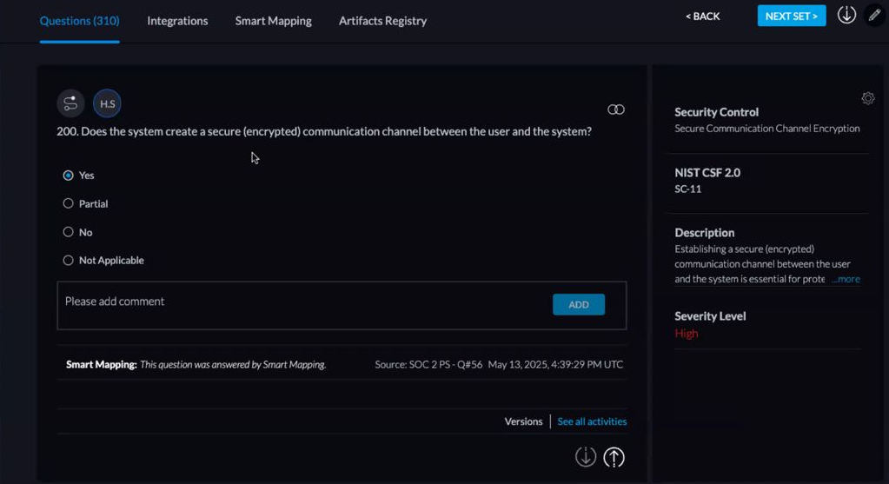

Slide 27
Key Considerations
Sustainability
  Paid or Free to SPs
  SPs using it for other compliance and governance requirements
Deployment Mode
  SaaS
  On-prem
Monitoring & Compliance
  A compliance and monitoring platfom (GRC) to ease compliance and monitoring by NCC
  NCC may sponsor the provision of same platform to enable service providers to report on audit and compliance (especially Tiers 2&3)

Slide 28
Subscription Options
Option 1
  NCC procures a bulk license sufficient to onboard all Service Providers only for the first year (Option 1A) or on an ongoing basis (Option 1B)
  NCC maintains the annual recurring license and maintenance costs
  This option allows only the implementation of the CRF-NCS and no other framework
Option 2
  NCC procures only the license for NCC-CSIRT to manage all SPs
  Service Providers procures own license based on need (only CRF-NCS or CRF-NCS plus other frameworks)
  SPs continue to renew their license on an ongoing basis

Slide 29
Deliverables
A GRC platform that is fully configured in line with the CRF-NCS and licensed to NCC.
Implementation Plan
Training Plan
Annual Maintenance Contract
Any other requirements to be specified by NCC in the signed scope of work

Slide 30
Implementation Issues
Vendor to provide professional services for deployment, migration, and training.
Best-practice templates and accelerators will be included.
Ongoing support (to be defined by SLA) for at least 24 months
Regular updates reflecting regulatory and cybersecurity landscape changes.

Slide 31
Project Duration
The duration of the project shall be twelve (12) weeks from the date of contract execution

Slide 32
Highlight of the Framework

Slide 33
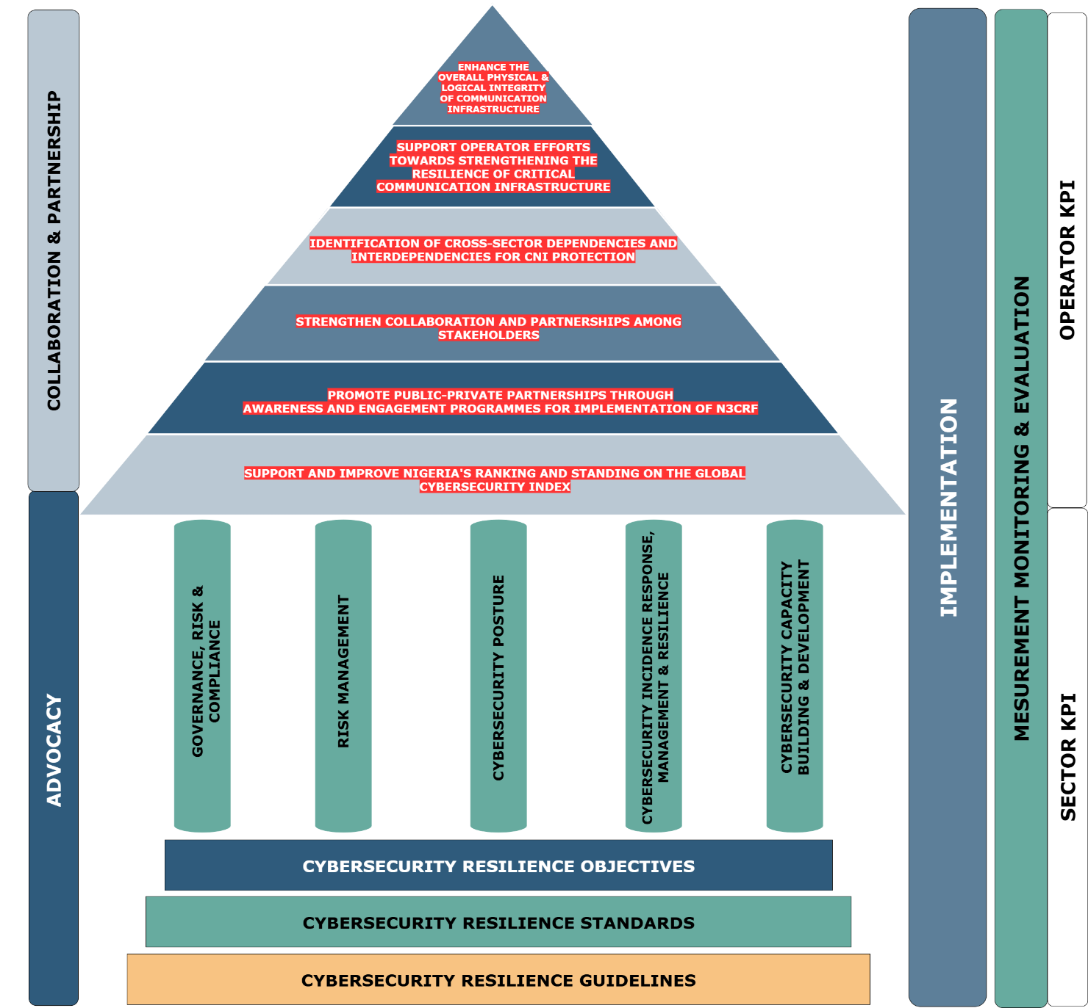
FRAMEWORK MODEL
The CRF-NCS is a process-focused, standards-based framework built around five core pillars of cyber resilience
This model integrates cyber resilience thinking throughout the process
Figure 4.2.1: CRF-NCS Model

Slide 34
FRAMEWORK STRUCTURE
Proactive measures cover various aspects from governance to risk management, cybersecurity awareness, and the numerous cybersecurity measures to protect the service providers’ IT and OT assets.
Cyber resilience (reactive) measures include the ability to detect, respond to, and recover from cybersecurity incidents.
Uniform Implementation: The framework also specifies guidelines to ensure standards are implemented in a uniform manner

Slide 35
FRAMEWORK STRUCTURE
Governance & Compliance (GC):
Implementation of governance policies, designate cybersecurity leadership, and comply with regulations and national laws.
Risk Management:
Asset management, threat analyses, situational awareness, and information sharing.
Cybersecurity Posture:
Technical and organisational protective measures securing digital assets.
Includes data protection, access controls, network security, cyber hygiene, and third-party risk management.
Incident Response, Management & Resilience:
Ensuring sector’s preparedness to detect, respond to, and recover from cyber incidents.
Key components include incident response planning, monitoring systems, and recovery mechanisms.
Capacity Building & Development:
Cybersecurity awareness, skill acquisition, talent development, research, and collaborative engagements among stakeholders.

Slide 36
THANK YOU

